Slide 1



OPPORTUNITY REVIEW
DIRECT-TO-EMPLOYER GTM STRATEGY
Exploring a Adena Health System DTE Health Plan

Slide 2


Founded in 1979, headquartered in Indianapolis
Largest Independently-Owned Full-Service Third-Party Administrator
Specialize in Administration of Self-Funded Plans and Population Health Management​
Leader in the Direct-to-Employer Movement
We Know and Understand the Market
Experience Working with All Professional Teams: Agents, Networks, MGAs
The Key Family of Companies is a Vertically Integrated group of benefit related organizations
3,000+ Corporate Clients
3 Million Members under Management
700 Employees

Slide 3



Our Founding and Heritage: 46 Years of Striving for Honesty in Healthcare

Slide 4
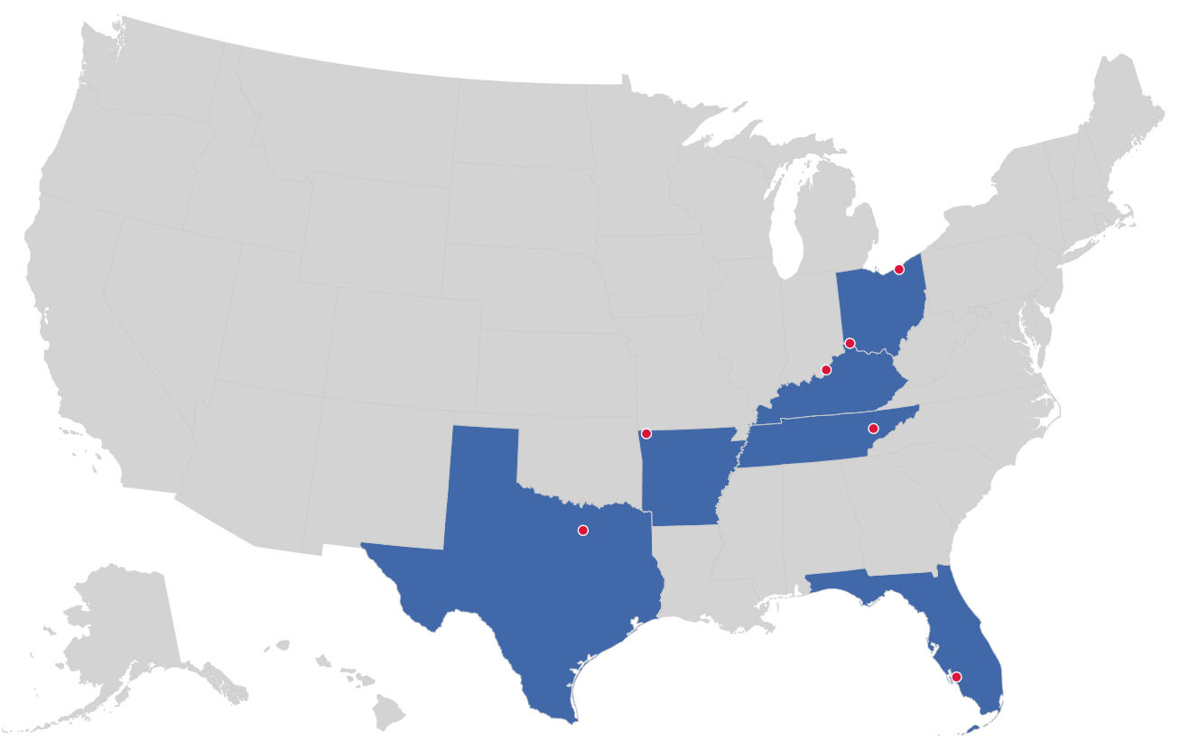

MARKET LEADER
IN
PRIVATE LABELED
DTE PLANS
Cleveland, OH
Louisville, KY
Cincinnati, OH
Bentonville, AR
Knoxville, TN
Dallas Fort Worth, TX
Fort Myers, FL

Slide 5


DIRECT-TO-EMPLOYER (DTE)
YOU Pick the Name of the Health Plan
YOU Determine the Fees Charged
YOU Practice the Medicine
YOU Receive the Profits
WE Make it Successful
Your Health Plan Focused on a Direct Relationship with Self-Funded Employers in Your Market

Slide 6
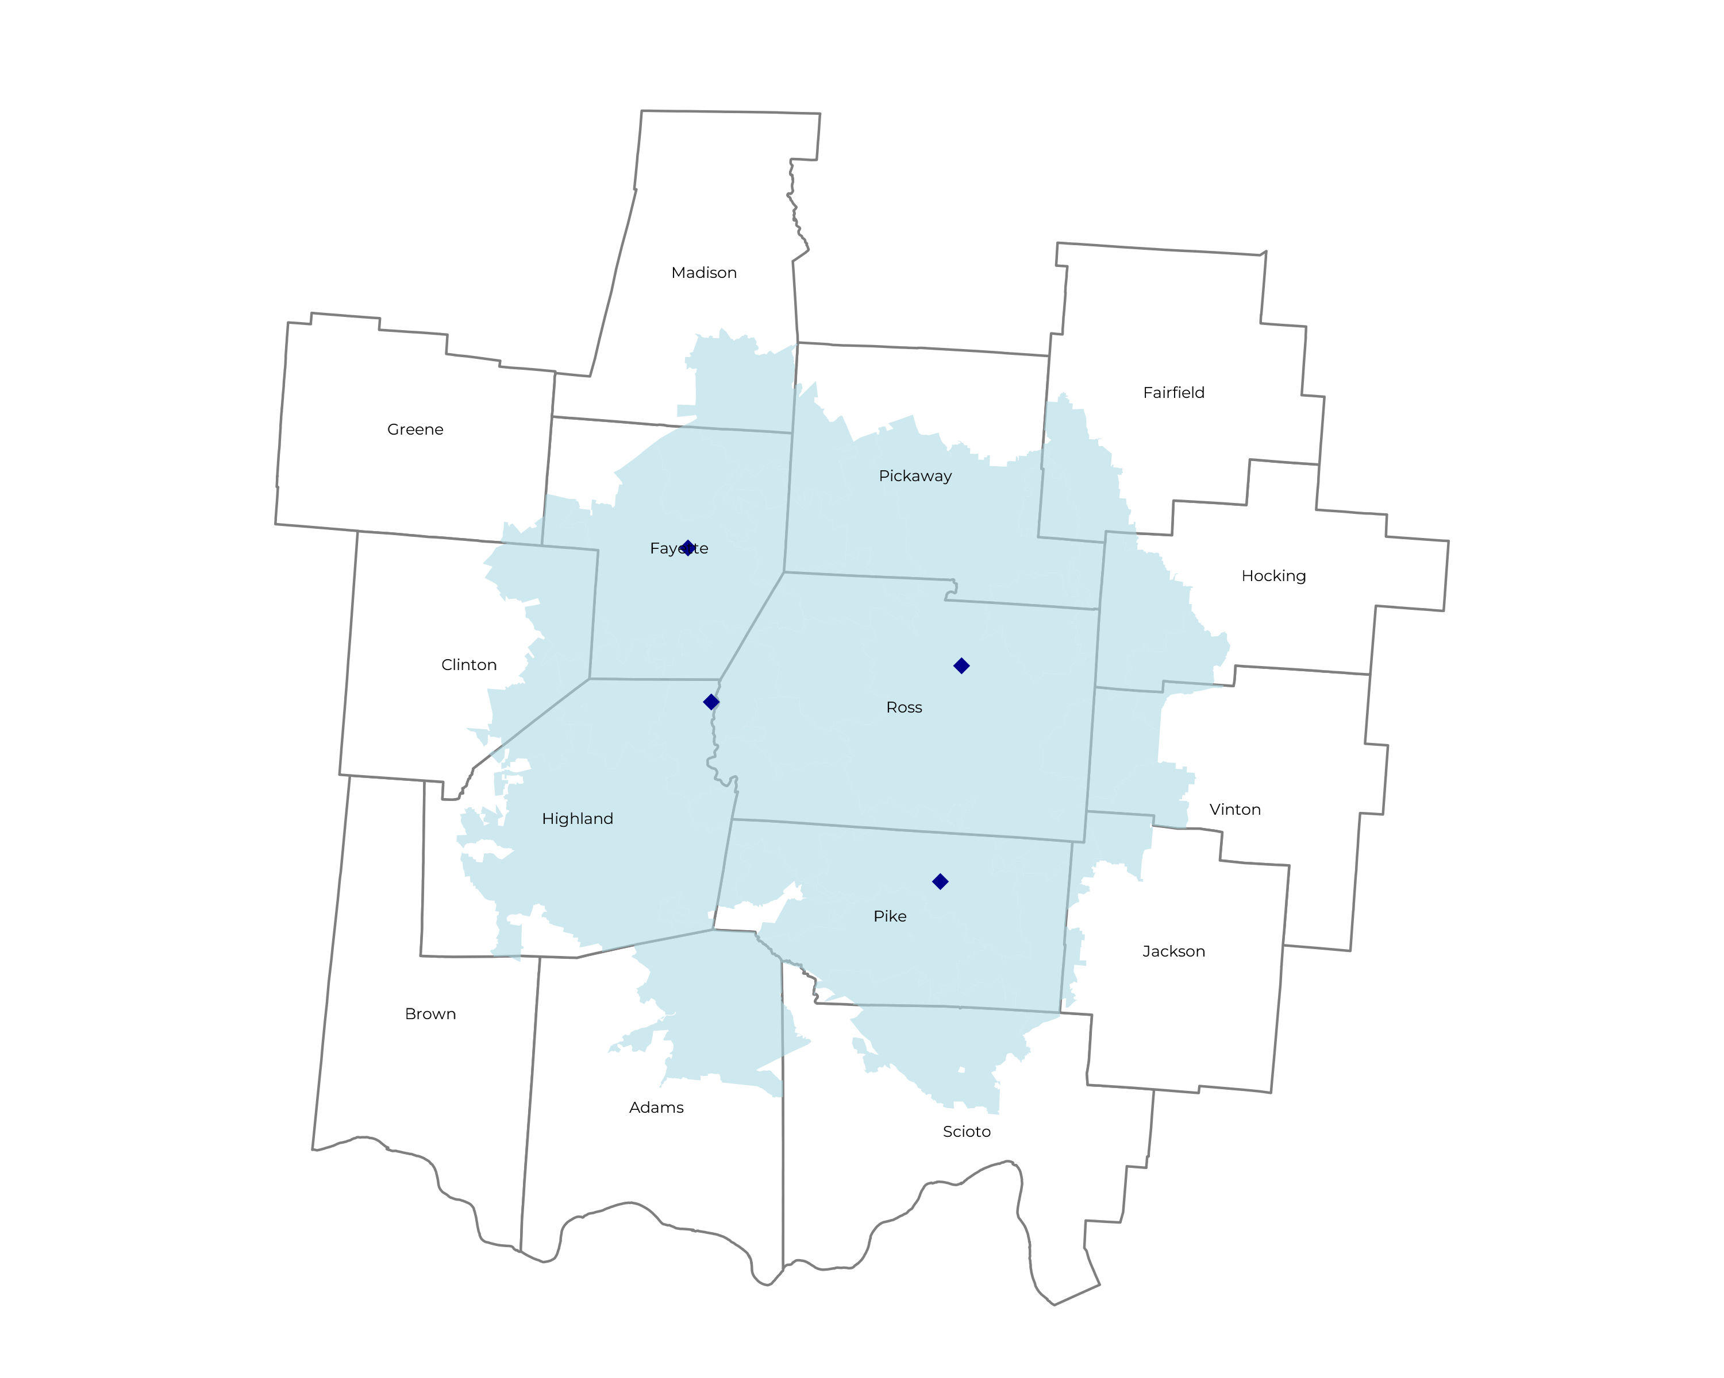
SIGNIFICANT OPPORTUNITY FOR PLAN GROWTH Researched for the below highlighted service area
Self Funded
59K
Insured
84K
Working Age
135K
Population
241K
Estimates includes the Adena Health System service area in Adams, Clinton, Fairfield, Fayette, Highland, Hocking, Jackson, Madison, Pickaway, Pike, Ross, and Scioto Counties

Slide 7
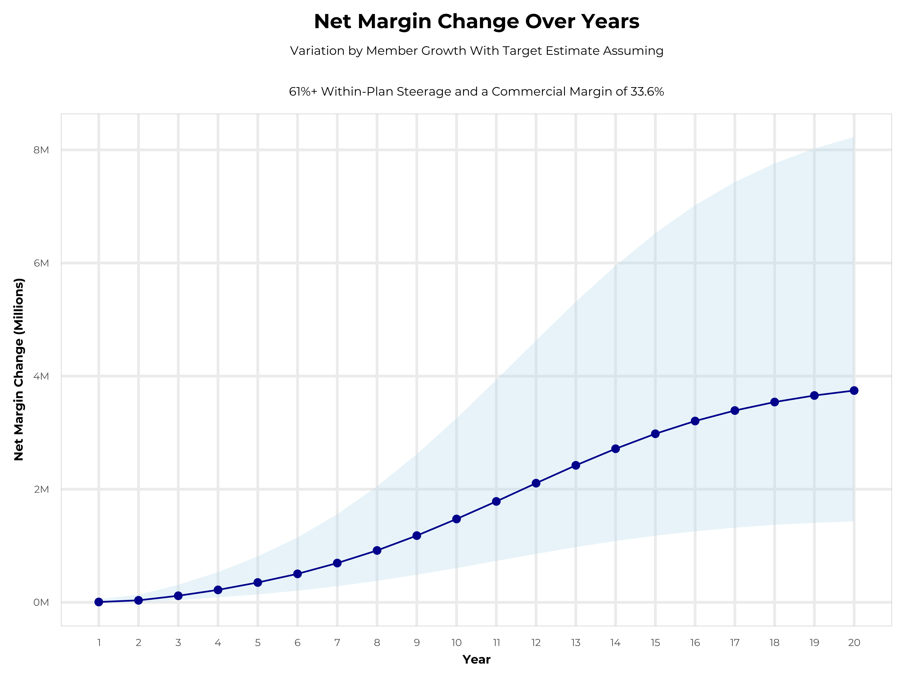
GROWING POWERFUL, LASTING PROFITABILITY
Early Stage
Gaining Name Recognition, Early Growth
New Revenue:
New Profit:
$0.66M
$0.21M
Growth Stage
Strong Reputation, Strong Growth
New Revenue:
New Profit:
$4.43M
$1.51M
Mature Stage
High Profitability, Market Saturation
New Revenue:
New Profit:
$9.67M
$3.32M

Slide 8
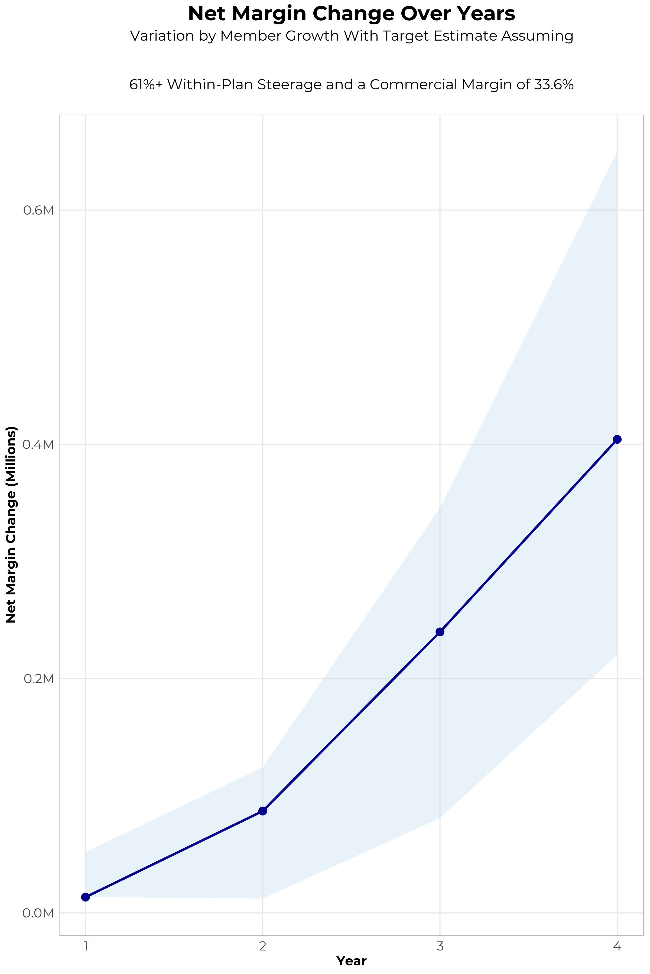
FOUR-YEAR PROJECTIONS
Target Member Growth | Target Member Growth | Target Member Growth | Target Member Growth | Target Member Growth
Metric | Year 1 | Year 2 | Year 3 | Year 4
Number of Members | 100 | 300 | 500 | 700
Incremental Margin | 37.3K | 108.3K | 258.9K | 420.9K
Network Access Fee | 1.2K | 3.6K | 6.0K | 8.4K
Implementation Fee (One-Time) | 0.0K | 0.0K | 0.0K | 0.0K
Sales and Marketing Costs | -25.0K | -25.0K | -25.0K | -25.0K
Net Margin Change | 13.5K | 86.9K | 239.9K | 404.3K
High Member Growth | High Member Growth | High Member Growth | High Member Growth | High Member Growth
Metric | Year 1 | Year 2 | Year 3 | Year 4
Number of Members | 200 | 400 | 700 | 1,100
Incremental Margin | 74.5K | 144.5K | 362.4K | 661.4K
Network Access Fee | 2.4K | 4.8K | 8.4K | 13.2K
Implementation Fee (One-Time) | 0.0K | 0.0K | 0.0K | 0.0K
Sales and Marketing Costs | -25.0K | -25.0K | -25.0K | -25.0K
Net Margin Change | 51.9K | 124.3K | 345.8K | 649.6K
Low Member Growth | Low Member Growth | Low Member Growth | Low Member Growth | Low Member Growth
Metric | Year 1 | Year 2 | Year 3 | Year 4
Number of Members | 100 | 100 | 200 | 400
Incremental Margin | 37.3K | 36.1K | 103.5K | 240.5K
Network Access Fee | 1.2K | 1.2K | 2.4K | 4.8K
Implementation Fee (One-Time) | 0.0K | 0.0K | 0.0K | 0.0K
Sales and Marketing Costs | -25.0K | -25.0K | -25.0K | -25.0K
Net Margin Change | 13.5K | 12.3K | 80.9K | 220.3K

Slide 9
PROJECTED PLAN GROWTH
Year | Employees | Members | Percent of Members Choosing Adena Health System for Inpatient Care | Percent of Members Choosing Adena Health System for Outpatient Care
1 | 100 | 200 | 66% | 51%
2 | 200 | 400 | 65% | 50%
3 | 300 | 500 | 70% | 55%
4 | 400 | 700 | 71% | 58%
5 | 600 | 1,100 | 71% | 60%
6 | 800 | 1,400 | 72% | 60%
7 | 1,000 | 1,800 | 72% | 61%
8 | 1,300 | 2,300 | 72% | 61%
9 | 1,700 | 3,100 | 72% | 62%
10 | 2,000 | 3,600 | 72% | 63%
11 | 2,400 | 4,300 | 73% | 63%
12 | 2,700 | 4,900 | 73% | 64%
13 | 3,100 | 5,600 | 73% | 64%
14 | 3,400 | 6,100 | 73% | 65%
15 | 3,600 | 6,500 | 74% | 66%
16 | 3,800 | 6,800 | 74% | 66%
17 | 4,000 | 7,200 | 74% | 66%
18 | 4,100 | 7,400 | 74% | 67%
19 | 4,200 | 7,600 | 74% | 67%
20 | 4,300 | 7,700 | 74% | 67%
KBA currently estimates that Adena Health System has 55% inpatient market share, and 40% outpatient market compared to hospitals/clinics in the Adena Health System service area (see slide 8).
Based on previous DTE experience, KBA expects a significant bump in patient steerage to Adena Health System.
Additional steerage will occur from additional steerage patient benefits and the patient convenience card.
High estimates start nearly 10% higher than target with low estimates at 10% lower than target

Slide 10
YEAR 4 PROJECTED REVENUE AND PROFIT
Pre-DTE Cohort of 700 Members | Inpatient | Outpatient | Professional | Total
Revenue† | $ 1,060,708 | $ 1,402,465 | $ 654,939.4 | $ 3,118,113
Net Income‡ | $ 356,397.8 | $ 471,228.4 | $ 220,059.6 | $ 1,047,686
† Assuming proportional revenues from market shares of 55% (inpatient) and 40% (outpatient)
‡ Conservatively assuming a commercial margin of 33.6% (80% of the estimated commercial margin)
With DTE | Inpatient | Outpatient | Professional | Total
Revenue⁰ | $ 1,367,876 | $ 2,029,884 | $ 947,938.7 | $ 4,345,699
Net Income* | $ 459,606.2 | $ 682,041.1 | $ 318,507.4 | $ 1,460,155
⁰ Assuming 71% inpatient and 58% market steerage based on KBA narrow network DTE experience (see previous slide)
* Conservatively assuming a commercial margin of 33.6%, with a 10 percentage-point reduction to reflect competitive-edge rates and a 10 percentage-point increase due to lower billing costs and higher patient responsibility collections because of the member convenience card.
Total Increase in Net Income | $ 412,468.8
Network Access Fee (Revenue) of $1 PMPM | $ 8,400
Total Profit Growth | $ 420,868.8
Minus Sales and Marketing (Annual – Ongoing) | -$ 25,000
Total | $ 395,868.8

Slide 11

A PARTNER YOU CAN TRUST
OUR OBJECTIVES ARE ALIGNED
WE KNOW THE
MARKET
COMPLETELY TRANSPARENT
WE HAVE THE SOPHISTICATION AND INFRASTRUCTURE TO EFFECTIVELY COMPETE
Derek Moore, Senior Vice President – KBA
845-283-9973 * derek.moore@keybenefit.com

